Slide 1

Property Values and Educational Performance: A Case Study in Montgomery County
Final Report
Liliane Effoudou
Data 205-3466

Slide 2
Objective: ANALYSING A RELATIONSHIP BETWEEN LOCAL PROPERTY VALUES AND STUDENT ACADEMIC PERFORMANCE IN MONTGOMERY COUNTY
Evaluating the Correlation Between Property Values and Academic Success
Determining if higher property values are associated with better student performance (e.g., graduation rates, college admissions rate) using only publicly available data.
Identifying Spatial Patterns in Education Outcomes
Using geographic data like school clusters to visualize whether regions with higher property values show consistently higher academic results.
Compare School-Level Academic Metrics Across Property Value Ranges
Analyzing differences in performance between schools located in high-value vs. low-value property areas.

Slide 3
Datasets used
DATASET | SOURCE | DESCRIPTION
List of Montgomery County Public Schools | www.datamongtomery.gov | List of all the schools in the county, along with their respective metrics.
Median Home Value in Montgomery County | Api.census.gov | API from the census bureau which lists the median home value of properties around the Montgomery County
Locations of Schools in Montgomery County | www.datamontgomery.gov | Coordinates of all the schools in the county.

Slide 4

Tools used
Python
All the analysis such as data cleaning, visualization, and modeling were performed with Python.
Packages used:
Pandas: used to read the datasets.
Seaborn and Matplotlib for visualization, analysis, and modeling.
Folium for heatmap display.
Squarify to visualize the clusters by order of value.
Statsmodels for the linear regression and ANOVA models.

Slide 5
Data cleaning and processing
List of School Dataset:
Cleaning:
Removing Charter, Elementary, Alternative, and Middle schools.
Removing school year column
Removing columns with missing values(military decision, school year)
Processing:
Schools were already organized by their respective clusters so that part was taken care of.
Merged with Median Home Value for further analysis
Merged with the Location Dataset and Median Home Value dataset to generate a heatmap.

Slide 6

Data cleaning and processing
Median Home Values API:
Cleaning:
Removing suffixes such as ‘CDP’ and ‘Town’ to rename the cities to properly organize and group them into clusters.
There were some cities that had to be omitted since they were added by the Census Bureau because of their similar names to other cities in the County (Potomac Heights and Potomac Park which are in Washington DC were included as being part of Potomac, Maryland), and their proximity to the county itself (Glen Burnie, Baltimore City).
Processing
Montgomery County high schools are grouped into clusters, but the Census Bureau's API did not reflect this structure. Therefore, clusters were manually created by assigning cities to their respective groups, and the datasets were merged to proceed with the analysis.

Slide 7
Exploratory Data analysis
List of School Dataset
Summary Statistics:

Slide 8
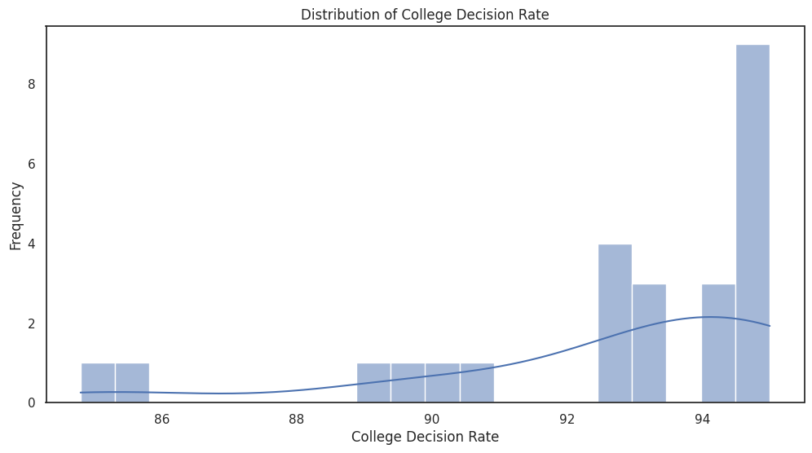
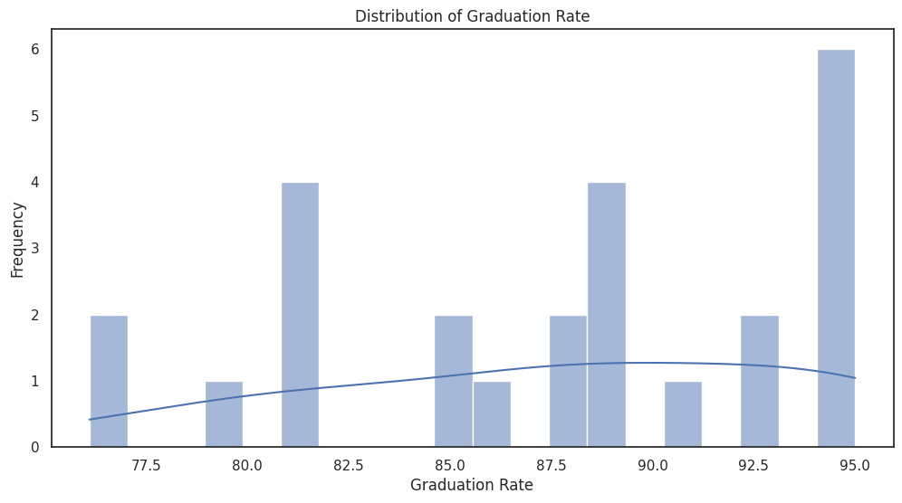
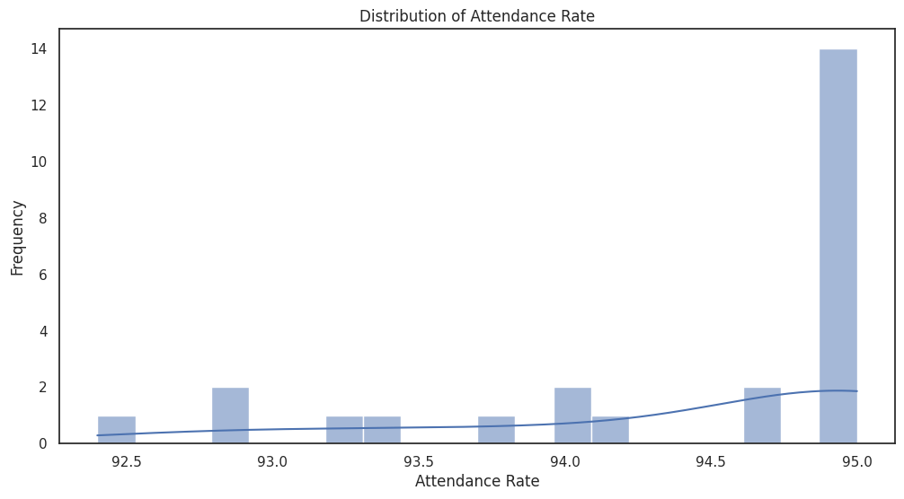
school eda cont’d

Slide 9
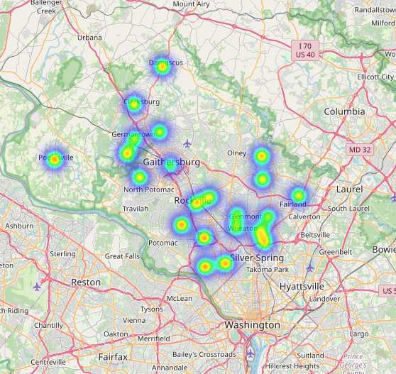
heatmap of graduation rates by city
areas with higher graduation rates shine the brightest
the distribution of graduation rates is even across the county, with some few areas shining brighter than others.

Slide 10
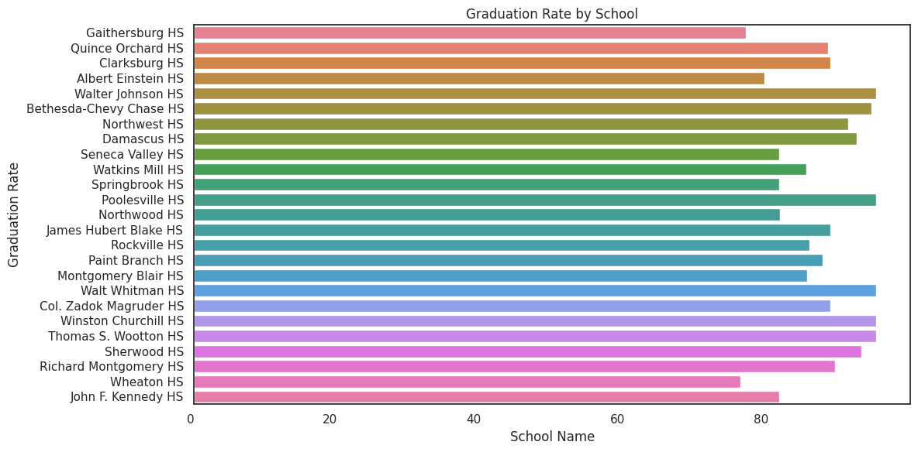
graduation rates
By School

Slide 11
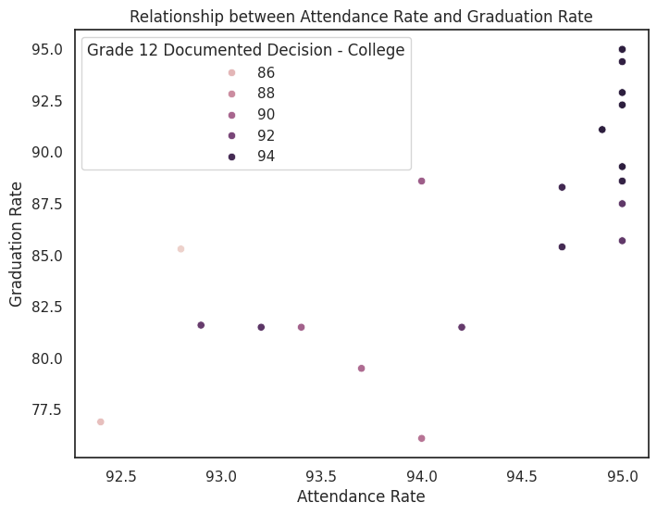
graduation rate vs. attendance rates
The higher the attendance rate, the higher the graduation rate.
the higher the attendance rate, the higher the college decision rate as well
most students have high attendance and high graduation rates.

Slide 12
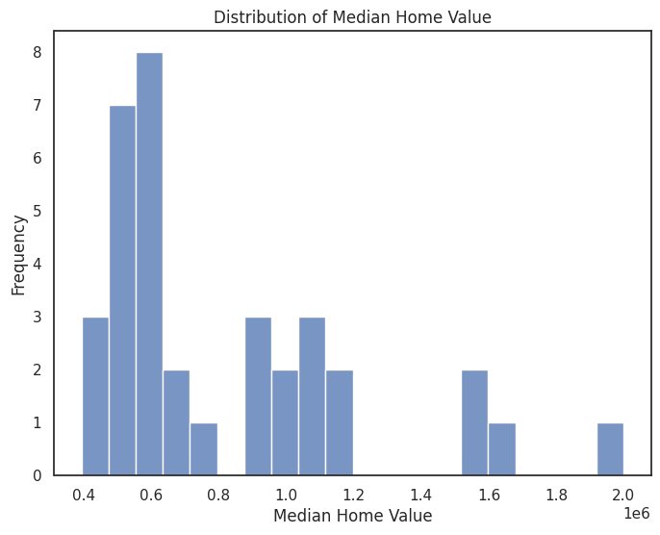
eda of median home value dataset
Summary Statistics for Median Home Value:
count:35.
mean:820805.7
std:389852.
min:393700.0
25%:535550.0
50%:626200.0
75%:1032400.0
max:2000001.0

Slide 13
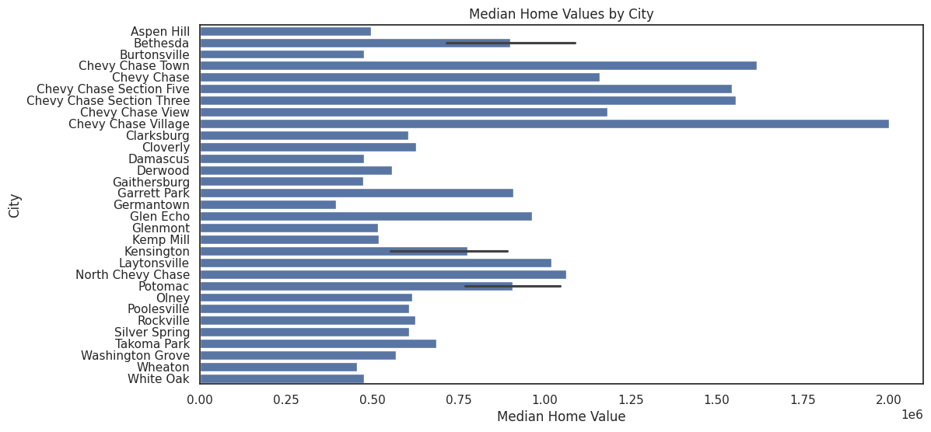
median home values by city
Distribution of wealth across the county
Chevy ranks as the most affluent, while Germantown ranks as the least.
Note: This analysis reflects city-level data only and does not account for school cluster boundaries.

Slide 14
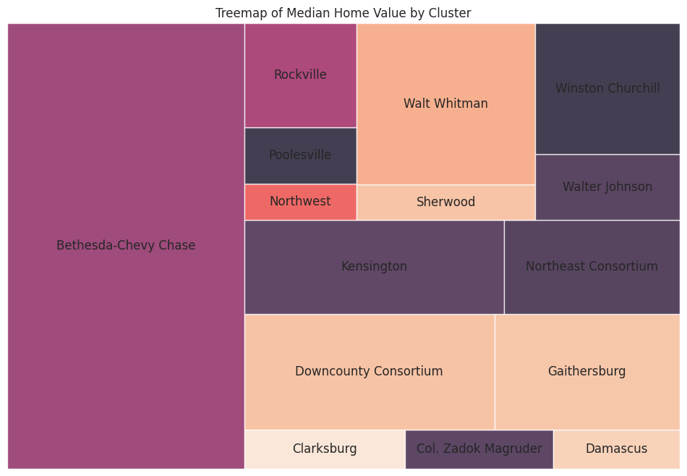
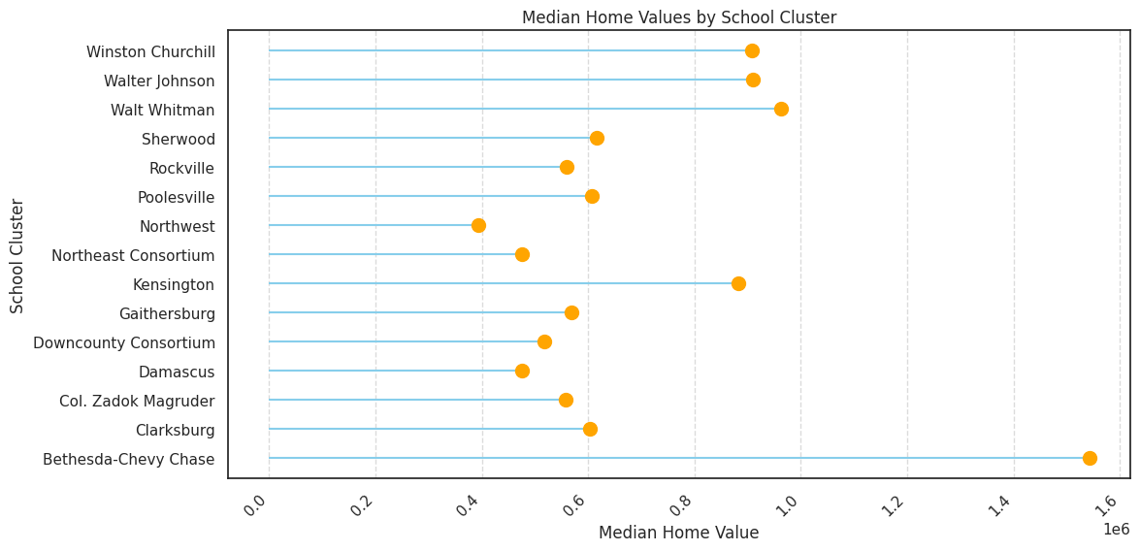
median home values by school cluster
The clusters are not evenly distributed in terms of property tax values, with the Northwest cluster having the lowest and the Bethesda-Chevy Chase cluster the highest.

Slide 15
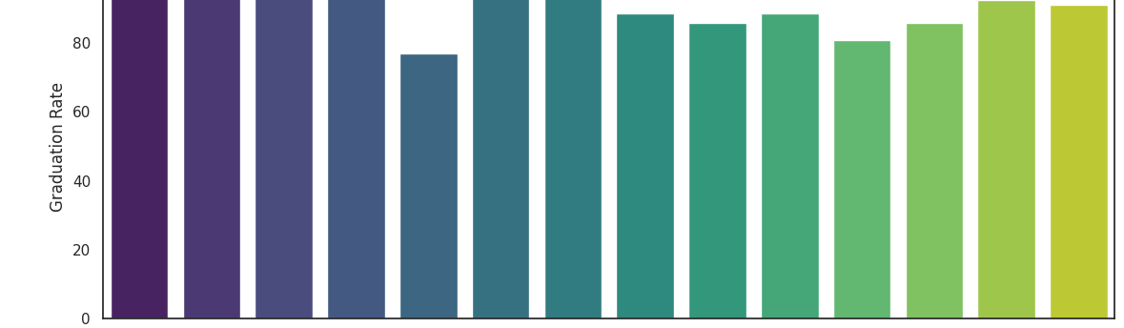
Graduation rate by school cluster
The four most affluent areas also have high graduation rates, though the differences in graduation rates among the clusters are relatively small.

Slide 16
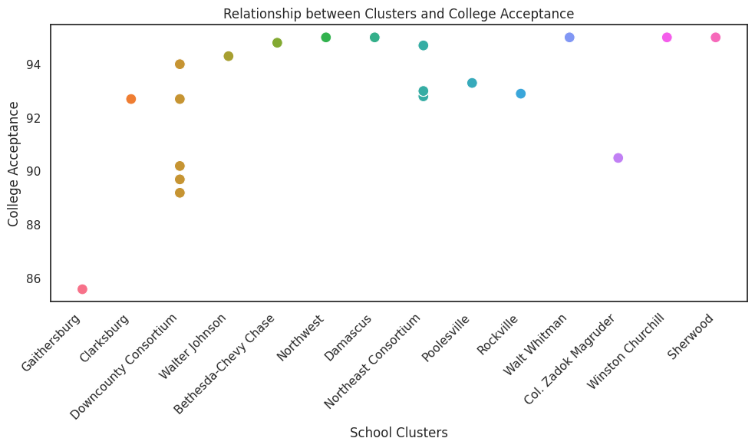
school clusters vs. college decision rate
apart from Gaithersburg, all other clusters maintain a college decision rate of over 89%, which is impressive.

Slide 17
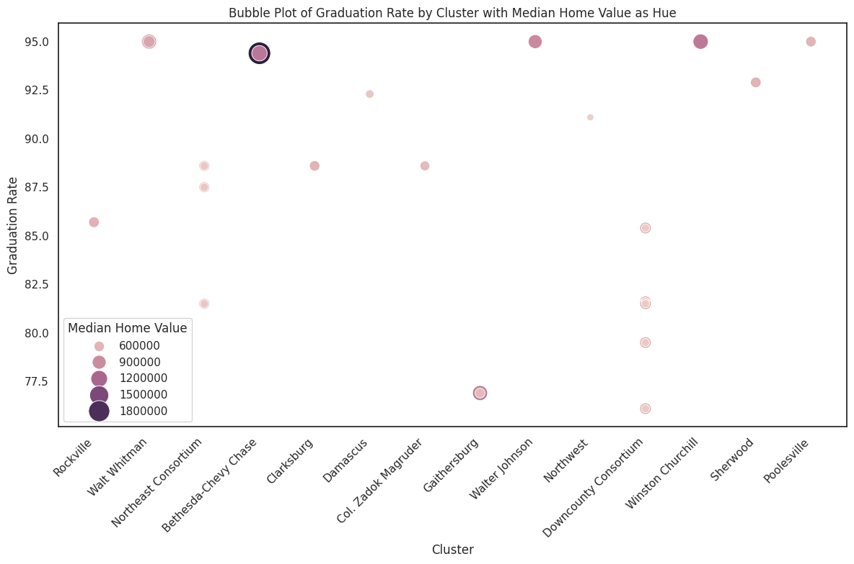
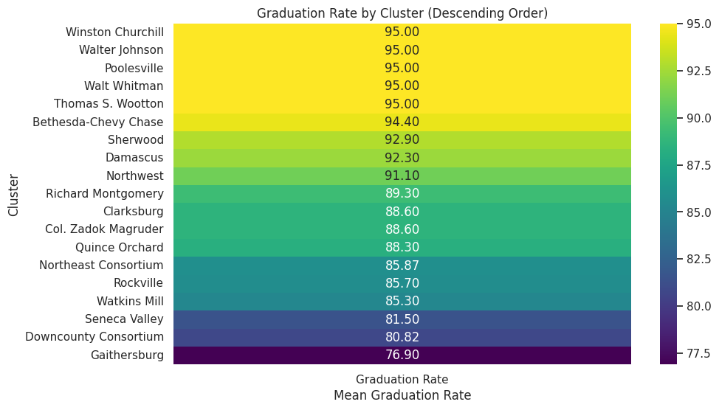
graduation rates by cluster
this distribution shows that the higher priced clusters also boast the most graduates, with Winston Churchill, Walter Johnson, and Bethesda-Chevy vying for the top five spots. Poolesville, Sherwood and Damascus also score high even though they are not located in expensive school clusters.

Slide 18

are graduation rates affected by median home value?

Slide 19
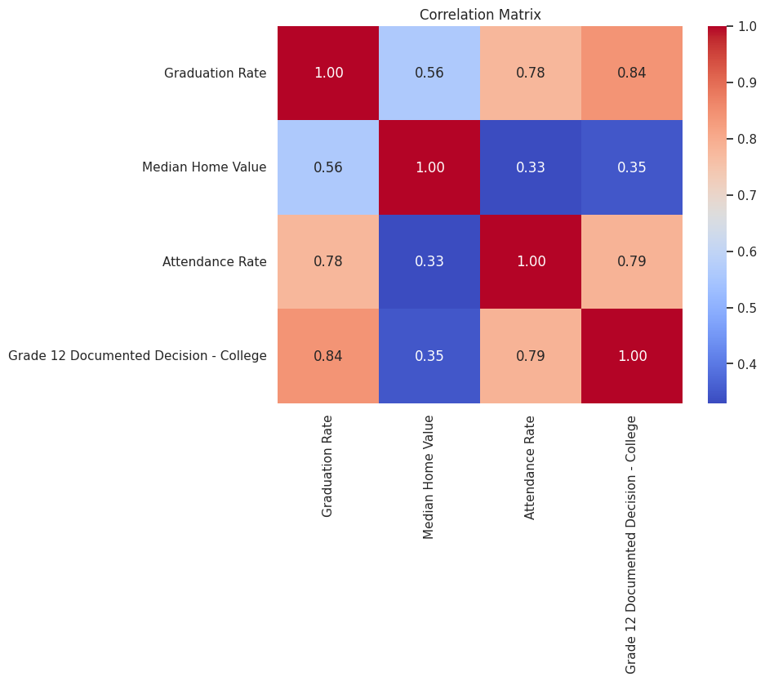
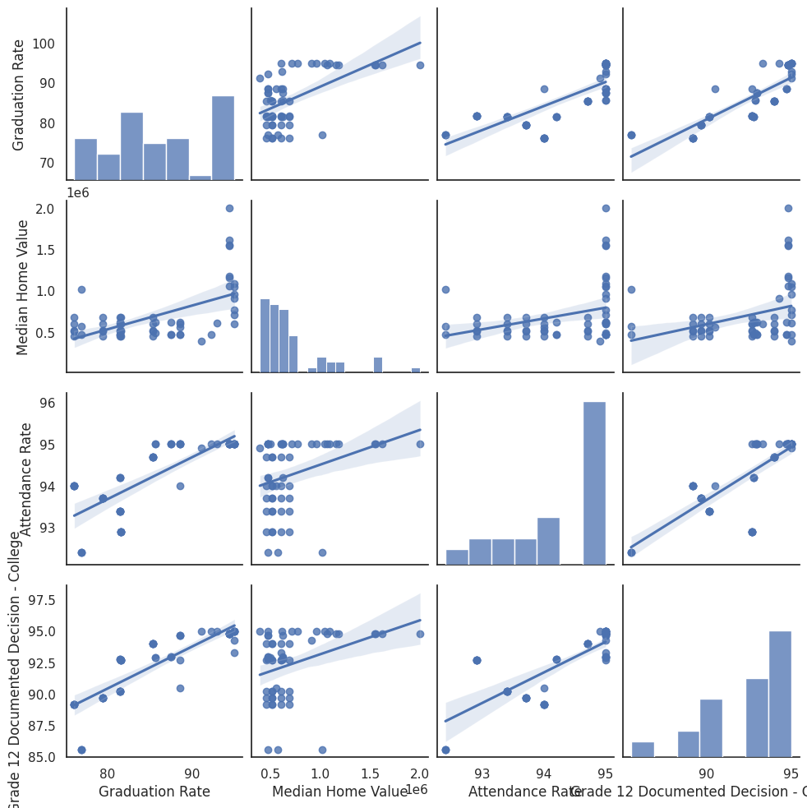
pair plot and correlation matrix of targeted values

Slide 20
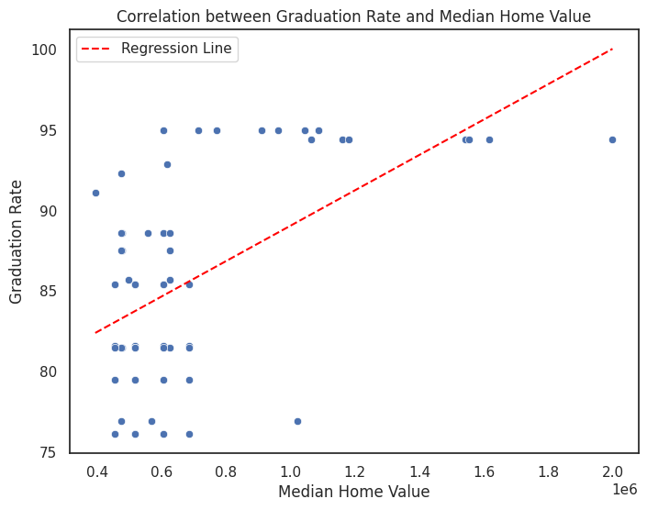
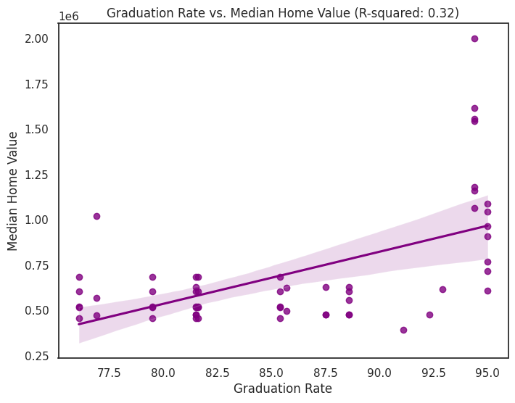
correlation between graduation rate and median home value
R-Squared: 0.32
P-Value: 0.00
Very slight association. We can conclude that there are other factors outside of median home value that attest to graduation rates.

Slide 21
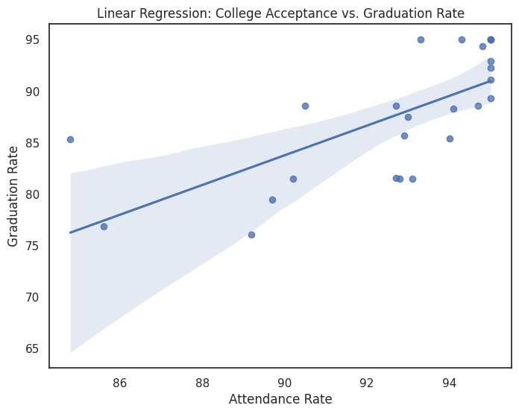
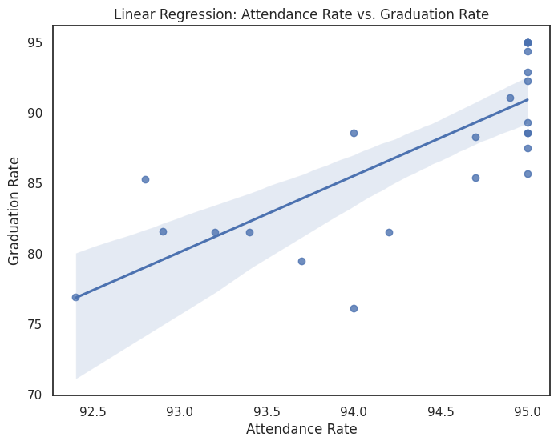
other factors that count as contributors
correlation between attendance rate and graduation rate: 0.76
R-squared: 0.59
P-value: less than zero.
There is a strong correlation between the two
correlation between graduation rate and college decision rate: .69
R-squared: .59
P-Value: less than zero
graduation rates do influence college decision.

Slide 22
in conclusion
although median home values can be a factor in a student’s success in school, its effect is not what drives the student to succeed.
attendance rates greatly influence student’s success, the more diligent a student is in that respect, the higher their chances are at graduating.
overall, students in the county seem to be performing at a significantly higher level with some school clusters ranking higher than others.

Slide 23
References and Acknowledgements
References:
U.S. Census Bureau. (2022). American Community Survey. https://api.census.gov/data/2022/acs/acs5
Data Montgomery. (2023). Public Schools. https://data.montgomerycountymd.gov/Education/Public-Schools/772q-4wm8/data_preview
Data Montgomery. (2013). School Participation Indicators. FY2013 MSDE School Participation Indicators - All Schools | MCPS - Open Data Portal
Acknowledgements: I would like to thank Professor Lori Perine for her guidance, feedback, and support throughout this project. I would also like to thank all the professors who have helped me through my Data Science Certificate:
Professor Amy Tchantou
Professor Rebin Muhammed
Professor Abdirisak Mohammed
I also acknowledge the use of certain programs, including:
Python for statistical analysis and data cleaning
Seaborn, Folium, Matplotlib for data visualization
statsmodel for statistical modeling.

Slide 24

thank you for listening

